Slide 1


WELCOME
To our project

Slide 2


LOGIN INTERFACE
Type User Name
USERNAME
…………
Type Password
Enter Login
LOGIN
Close
Remember me
Forget Password

Slide 3

Online Medical Service Management System
MAIN MENU
1)Doctors
2)Patients
3)Medicines
4)Laboratories
5)Facilities
6)Staffs

Slide 4

DOCTOR SECTION
1.Insert Doctor
2.Show all Doctor
3. Delete Doctor

Slide 5

Name:*********
ID:*****
Qualification:********
Specialization: *******
Work Time:****
Room No:***
**Return to back press 1 and for Main menu press 0

Slide 6
DOCTOR SECTION
1.Insert Doctor
2.Show all Doctor
3. Delete Doctor

Slide 7

Name ID Qualification Specialization Work Time RoomNo
Dr.Raja 122 Physician MBBS,MD 12-3 124
Dr.Sids 123 Surgeon MBBS,MS 3-6 123
**Return to back press 1 and for main menu press 0

Slide 8
DOCTOR SECTION
1.Insert Doctor
2.Show all Doctor
3. Delete Doctor

Slide 9
Name ID Qualification Specialization Work Time RoomNo
Dr.Raj 123 Surgeon MBBS,MS 3-6 123
**Return to back press 1 and for main menu press 0

Slide 10
Online Medical Service Management System
MAIN MENU
1)Doctors
2)Patients
3)Medicines
4)Laboratories
5)Facilities
6)Staffs

Slide 11

PATIENTS SECTION
1.Insert Patients
2.Show all Patients
3.Delete Patients

Slide 12

Name:*********
Id:*******
Disease: *******
Gender:*****
Admit Status:********
Age:***
**Return to back press 1 and for Main menu press 0

Slide 13
PATIENTS SECTION
1.Insert Patients
2.Show all Patients
3.Delete Patients

Slide 14

Name ID Disease Gender Admit Status Age
Farhan 20 Cancer Male X 50
Jihan 21 Diabetes Male Y 60
Nadia 23 Cold Female Z 29
**Return to back press 1 and for main menu press 0

Slide 15
PATIENT SECTION
1.Insert Patients
2.Show all Patients
3.Delete Patients

Slide 16
Name ID Disease Gender Admit Status Age
Fariha 25 Cancer FeMale X 30
Nila 27 Cold Female Z 20
**Return to back press 1 and for main menu press 0

Slide 17
Online Medical Service Management System
MAIN MENU
1)Doctors
2)Patients
3)Medicines
4)Laboratories
5)Facilities
6)Staffs

Slide 18

Medicine SECTION
Medicine SECTION
1.Insert Medicine
2.Show all Doctor
3. Delete Doctor
1.Insert Medicine
2.Show all Medicine
3. Delete Medicine

Slide 19
Name of medicine:-
Company name of medicine:-
Expire date:-
Cost of medicine:-
No. of unit:-

Slide 20
Medicine SECTION
Medicine SECTION
1.Insert Medicine
2.Show all Doctor
3. Delete Doctor
1.Insert Medicine
2.Show all Medicine
3. Delete Medicine

Slide 21
*Not only existing but also new added data of medicine will be shown*
Name Company Expiry Date Cost No.of Unit
Napa Square pvt 9-5-16 55 01
Sergel Ace pvt 4-4-15 70 02
Rynex Reckitt 12-7-17 50 03

Slide 22
Medicine SECTION
Medicine SECTION
1.Insert Medicine
2.Show all Doctor
3. Delete Doctor
1.Insert Medicine
2.Show all Medicine
3. Delete Medicine

Slide 23
*Not only existing but also new added data of medicine will be shown*
Name Company Expiry Date Cost No.of Unit
Amaryl Sanofi pvt 10-9-19 70 05
Sitagil Incepta pvt 7-5-15 90 06

Slide 24
Online Medical Service Management System
MAIN MENU
1)Doctors
2)Patients
3)Medicines
4)Laboratories
5)Facilities
6)Staffs

Slide 25



STAFF SECTION
1.Insert Staffs
2.Show all Staffs
3.Delete Staffs
1.Insert Laboratories
2.Show all Laboratories

Slide 26


Enter Laboratories Facility Name :-
Enter Cost of New Facility:-

Slide 27
*Not only existing but also new added data of Laboratories will be shown*
Laboratories Fecilities Cost
X-ray 800
CT Scan 1200
OR Scan 500

Slide 28
STAFF SECTION
1.Insert Staffs
2.Show all Staffs
3.Delete Staffs
1.Insert Laboratories
2.Show all Laboratories

Slide 29
Laboratories Section
Laboratories Fecilities Company Name
X-ray Square
CT Scan Ibn Sina
OR Scan Medinova

Slide 30
Online Medical Service Management System
MAIN MENU
1)Doctors
2)Patients
3)Medicines
4)Laboratories
5)Facilities
6)Staffs

Slide 31
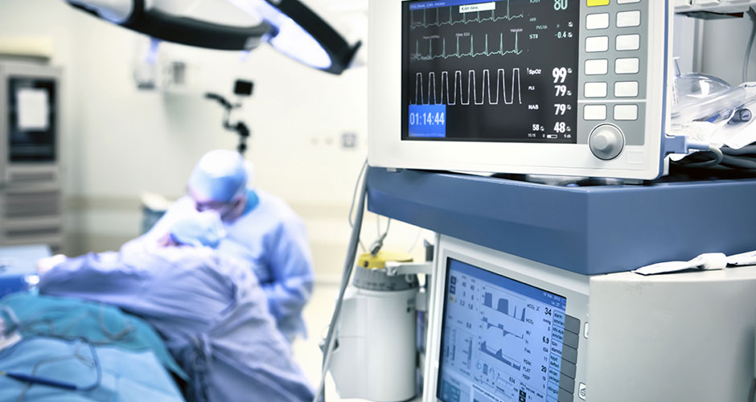
STAFF SECTION
Facilities Section
1.Insert Staffs
2.Show all Staffs
3.Delete Staffs
1.Insert Facilities
2.Show all Facilities
1.Insert Facilities
2.Show all Facilities

Slide 32

Facilities SECTION
1. Ambulance
2.Admit Facility
3.Emergency
4.Bed
5.X-Ray
6.CT Scan

Slide 33
STAFF SECTION
Facilities Secton
1.Insert Staffs
2.Show all Staffs
3.Delete Staffs
1.Insert Facilities
2.Show all Facilities
1.Insert Facilities
2.Show all Facilities

Slide 34
Facilities Information
1. Birth Centers
2.Dialysis Centers
3.Urgent Care
4.Blood Banks
**Return to back press 1 and for Main menu press 0

Slide 35
Online Medical Service Management System
MAIN MENU
1)Doctors
2)Patients
3)Medicines
4)Laboratories
5)Facilities
6)Staffs

Slide 36

STAFF SECTION
1.Insert Staffs
2.Show all Staffs
3.Delete Staffs

Slide 37
ADD NEW ENTRY
Id:*********
Name:****** *******
Designation: *******
Sex :**
Salary:****
**Return to back press 1 and for Main menu press 0

Slide 38
STAFF SECTION
1.Insert Staffs
2.Show all Staffs
3.Delete Staffs

Slide 39
Name ID GENDER Designation SALARY
Komal 202 Female Nurse 8000
Rani 203 Female Worker 5000
Rana 102 Male Security 5000
Jolly 301 FeMale Nurse 8000
**Return to back press 1 and for Main menu press 0

Slide 40
STAFF SECTION
1.Insert Staffs
2.Show all Staffs
3.Delete Staffs

Slide 41
Name ID GENDER Designation SALARY
Rani 203 Female Worker 5000
Rana 102 Male Security 5000
Jolly 301 FeMale Nurse 8000
**Return to back press 1 and for Main menu press 0

